Slide 1

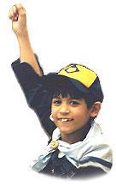
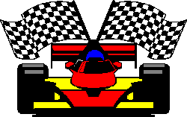

Shia Imami Ismaili Scouts – Pack 758
Nov 17th 2019
Pinewood Derby

Slide 2


History
"I wanted to devise a wholesome, constructive activity that would foster a closer father-son relationship and promote craftsmanship and good sportsmanship through competition."
Don Murphy,
Founder of the Pinewood Derby in 1953
Manhattan Beach, CA Cub Scout Pack 280C

Slide 3
History
The first Pinewood Derby was held in 1953 by Cub Scout Pack 280C of Manhattan Beach, California. The first reference to the Pinewood Derby in a Scout publication was in the October, 1954 issue of Boy's Life.
Little has changed in the derby since 1953. During that time an estimated 43 million sons and fathers (mostly) have participated. And today's generation of Cub Scouts, moms and dads share the same fun, thrills, and rewarding moments. Today, over 80 million car kits have been sold.

Slide 4
What is a Pinewood Derby?
A bunch of fun! At the end it is a Pack of Cub Scouts racing little wooden cars of various shapes and colors on little plastic wheels down a 32' plywood track. But that is only a small part of it. Each Cub Scout gets a kit with a block of wood, four nails for axles, and four plastic wheels. Then, based on the rules, he shapes and paints his block or wood into a form to race down the track.
The Track's start line is approximately 5 feet high, and the track slopes down to the floor and levels off for the final 32 feet or so.

Slide 5
The Purpose
The purpose of the Pinewood Derby is to help the Cub Scout build a team relationship with their parent or helper, experience the sense of accomplishment and the excitement of Learning, Competition, and Sportsmanship.
Learning: Concept of friction & gravity. How to work with power tools safely.
Competition: There is always a person that wins and a person that loses. Competition drives us to do our best. By participating and competing, we broaden our knowledge, skills and become a better person. The only loser is the person that refuses to better him.
Sportsmanship: Sportsmanship involves both following the rules and how you behave at the derby. No matter how your car performs, you want to behave in a manner that will allow you to feel good in days to follow.
Like all successful events, it requires some planning and preparation, but the payoff in fun and strengthening family relationships has been proven over the years.

Slide 6
How Do You Race?
The cars are gravity powered, and run down a track of six lanes. The cars are placed on the starting line, the judge pulls the starting device, and they are off, heading for the finish.

Slide 7
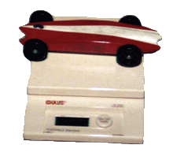
Weight! - The Biggest Factor
Probably the biggest issues about how well a car runs down the track, and the biggest issues surrounding the rules, is with the weight of the cars. During the workshop, the weight of the cars is the one thing that most Scouts and parents focus on.

Slide 8
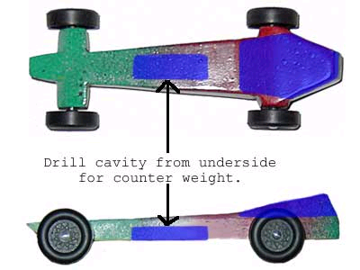
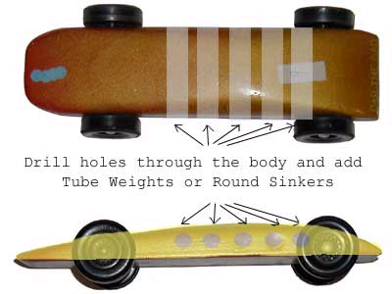
Where Do I Put Weight?

Slide 9
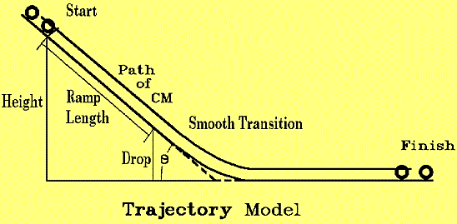
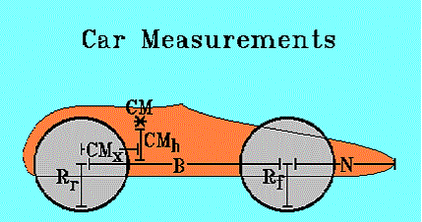
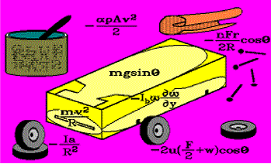
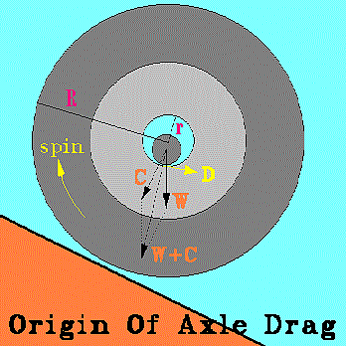
Is it a Science?

Slide 10
What is The JUDGE?
The JUDGE is a compact and rugged electronic finish line for the Cub Scout Pinewood Derby, and other similar programs. It declares the finishing order, displaying the win, place and show cars on the big screen immediately to the audience. It makes use of the latest electronic technology, and is superbly crafted to perfectly fit any track.

Slide 11
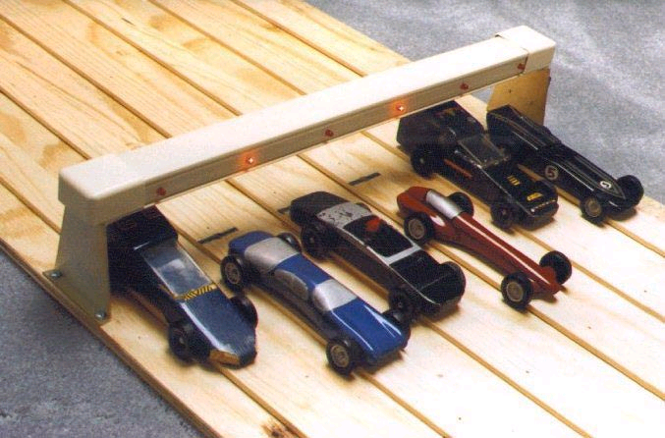
The JUDGE?

Slide 12

Why do I need The JUDGE?
Close races are very difficult to judge by eye. Contested races and reruns burn up time, and often do not solve the hard feelings. Children with less aggressive parents are at a disadvantage. These realities can take the fun out of an otherwise dynamite youth program.
With The JUDGE, there are no disputes. Everyone trusts the validity of electronic judging. Derby runs smoothly, and finishes on time. Everyone is happy and looking forward to next year.

Slide 13
Guidelines
Participation: Open to all Pack 758 Tigers, Wolfs, Bears, Webelos & Arrow of Lights Scouts.
  You Must be Present to Compete!
  You Can Not Reuse Car from Last Year Derby!
Inspection: Cars will be inspected during registration for compliance to the BSA rules and specifications.
Impound: Cars will be impounded when registered. After being impounded, repairs will be limited to replacement of axles/wheels that are broken/lost during the race.

Slide 14
Specifications
BODY: The body in the Official BSA Pinewood Derby Kit must be used. Bodies of other materials will be grounds for disqualification. The body may be shaped, hollowed out, or built up from the original block, as long as it meets all other specifications. Any additions to the original body, i.e. steering wheels, drivers, decals, paint, weights, etc., must be firmly attached.
WIDTH: The car width at the wheels may not be modified, it must be the same as the original kit. Width must not exceed 2 3/4".
LENGTH: Overall length may not exceed 7".
WHEELBASE: Wheelbase may not be modified, it must be the same as the official kit.

Slide 15
Specifications
WHEELS: Wheels and Axles must be as furnished in the official kit. NO washers, bushings, bearings or springs are allowed. Wheels may be sanded to remove the flashing only. NO reductions in width or diameter, or changes in shape are allowed.
WEIGHT: The weight of the race-ready car must not exceed five (5) ounces (142 grams) as measured on the official scales.
OTHER: Cars must free-wheel with no stored energy or movable weights. There is no designated front or back to the supplied body, either end may be the front.

Slide 16

Outlaw Car Race
1- Open for all the parents of the registered Cub Scouts
2- Only One car per family will be allowed to participate
3- Most rules will not apply:
  Do not alter the wheel base
  Maximum weight: 16 ounces
4- Prizes will be awarded for 1st, 2nd and 3rd place winners

Slide 17
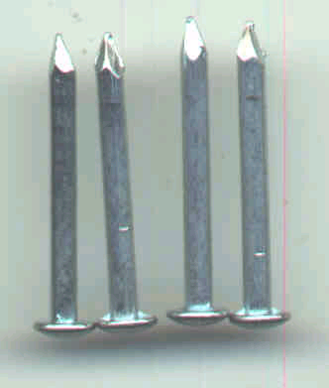
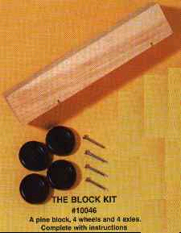
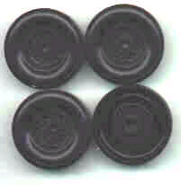
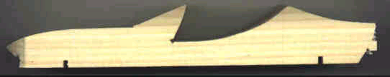
Process Sequence
Orientation
Wood Filler
Mount
Wheels/Axles
Design/Draw
Sand/Finish
Keep in
Safe Place
Cut
Paint
Qualify &
Register
Shape/Sand
Install
Accessories
Race
Add Weight
Apply Stickers

Slide 18
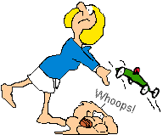

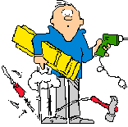
Safeguard Your Car

Slide 19

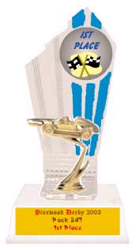

Awards
Racers will be divided into TIGER, WOLF, BEAR, WEBELOS, and ARROW OF LIGHT divisions. Three finalists will be determine in each division. There will be judging for 10 additional awards in the categories MOST UNIQUE, MOST ORIGINAL, and BEST LOOKING ETC.
You must be present to race!

